Slide 1
Line asset
datasets
Point asset datasets
Cycle lanes and tracks
cycle_lane_track
Advanced Stop Lines
advance_stop_line
Cycle parking
cycle_parking
Signals
signal
Traffic calming
traffic_calming
Crossings
crossing
Restricted routes
restricted_route
Signage
signage
Restricted points
restricted_point
Common variables
Unique variables

Slide 2
Common data fields |  | These data fields are present for every asset type
Variable name | Label | Description | Data type
FEATURE_ID | Feature ID | Unique ID for asset | Character
SVDATE | Survey Date | Date asset was surveyed | Date
BOROUGH | Borough | London Borough in which asset is located | Character
LATITUDE | Latitude | Geographical reference of asset | Geometry coordinates
LONGITUDE | Longitude | Geographical reference of asset | Geometry coordinates
PHOTO1_URL | Photo1 URL | URL for asset photo 1 | Character
PHOTO2_URL | Photo2 URL | URL for asset photo 2 | Character
geometry | Geometry | A spatial tibble of simplefeatures | sfc_MULTILINESTRING
Latitude and longitude converted to simple features geometry

Slide 3
Advanced Stop Lines |  | Advance stop lines (ASL) are located at traffic signals to provide an area for cyclists to wait for the traffic signals to change ahead of the general traffic. The ASL reservoir is the area between the solid stop line, level with the signals, and the ASL for general traffic. The reservoir may have a coloured surface and have a cycle symbol in the centre.
Variable name | Label | Description
ASL_FDR | Feeder Lane | True = Feeder lane present False = No feeder lane present (may be gate)
ASL_FDRLFT | Feeder Lane on Left | True = Feeder lane is aligned left next to kerb False = Feeder lane is not aligned left next to kerb
ASL_FDCENT | Feeder Lane in Centre | True = Feeder lane is in the centre of the Advanced Stop Line False = Feeder lane is not in the centre of the Advanced Stop Line
ASL_FDRIGH | Feeder Lane on Right | True = Feeder lane is aligned to far side of lane False = Feeder lane is not aligned to far side of lane
ASL_SHARED | Shared Nearside Lane | True = Shared nearside lane False = Not a shared nearside lane
ASL_COLOUR | Colour | Colour of advanced stop line - Limited to only the following entries: None, Green, Red, Blue, Buff/Yellow, Other

Slide 4
Crossings
Variable name | Label | Description
CRS_SIGNAL | Signal-Controlled Crossing | True = Controlled False = Uncontrolled (e.g. zebra)
CRS_SEGREG | Segregated cycles and Pedestrians | True = Cyclists segregated False = Shared with other users (e.g. pedestrians or horses)
CRS_CYGAP | Cycle Gap | True = Crossing includes gap in island or kerb allowing cyclists only (NOT a refuge) False = Crossing does not include gap in island or kerb
CRS_PEDEST | Pedestrian-Only Crossing | True = Cyclists must dismount to use False = Not a pedestrian-only crossing
CRS_LEVEL | Level Crossing | True = Crossing or rail/tram tracks on cycle lane/track False = Not a level crossing

Slide 5
Cycle Lanes and Tracks
Variable name | Label | Description
CLT_CARR | On-Carriageway or Off-Carriageway | True = On-carriageway False = Off-carriageway
CLT_SEGREG | Segregated Lane/Track | True = Fully segregated lane (i.e. On carriageway) / track (i.e. Off carriageway) False = Not fully segregated
CLT_STEPP | Stepped Lane/Track | True = Stepped lane/track False = Not a stepped lane/track
CLT_PARSEG | Partially Segregated Lane/Track | True = Partially or light segregated lane/track False = Not a partially or light segregated lane/track
CLT_SHARED | Shared Lane or Footway | True = Shared lane (eg bus lane) False = Shared footway or track
CLT_MANDAT | Mandatory Cycle Lane | True = Mandatory lane False = Not a mandatory lane
CLT_ADVIS | Advisory Cycle Lane | True = Advisory lane False = Not an advisory lane
CLT_PRIORI | Cycle Lane/Track Priority | True = Cycles have priority, other traffic has to give way False = Cycles do not have priority
CLT_CONTRA | Contraflow Lane/Track | True = Contraflow lane/track (NOT if bi-directional) False = With flow
CLT_BIDIRE | Bi-directional | True = Two way flow on lane/track/path False = Single direction lane/track/path
CLT_CBYPAS | Cycle Bypass | True = Bypass allowing turn without stopping at traffic signals False = Not a cycle bypass
CLT_BBYPAS | Continuous Cycle Facilities at Bus Stop | True = Cycle track carries on through the bus stop area False = Not a continuous cycle facility
CLT_PARKR | Park Route | True = Road/lane/track through park False = Not a park route
CLT_WATERR | Waterside Route | True = Route beside river, canal or other watercourse False = Not a waterside route
CLT_PTIME | Part-time (if true) or Full-time (if false) | True = Part-time False = Full-time
CLT_ACCESS | Access Times | Times route is accessible (either exact times or description)
CLT_COLOUR | Colour | Colour of lane/track - Limited to only the following entries: None, Green, Red, Blue, Buff/Yellow, Other

Slide 6
Restricted route
Variable name | Label | Description
RES_PEDEST | Pedestrian-Only Route | True = Pedestrian-only route linking cycle routes False = Not a pedestrian-only route
RES_BRIDGE | Pedestrian Bridge | True = Route includes a pedestrian bridge False = Route does not include a pedestrian bridge
RES_TUNNEL | Pedestrian Tunnel | True = Route includes a pedestrian tunnel/subway False = Route does not include a pedestrian tunnel/subway
RES_STEPS | Steps | True = Route includes steps to/from a particular cycle route which form part of a linear link route False = No steps
RES_LIFT | Lift | True = Route includes lift to/from a particular cycle route which forms part of a linear link route False = No lift

Slide 7
Cycle Parking
Variable name | Label | Description
PRK_CARR | Carriageway | True = On carriageway False = Off carriageway
PRK_COVER | Covered | True = Covered or sheltered (including partial shelter) False = No cover
PRK_SECURE | Secure | True = Locked compound with shared or combination lock provided by operator False = Not a locked compound
PRK_LOCKER | Locker | True = Locker using own or integral lock False = No locker present
PRK_SHEFF | Sheffield Stand | True = Sheffield stand (including TfL type) or variant False = Not a sheffield stand
PRK_MSTAND | "M" stand | True = "M" stand (variety of stand that resembles a letter M) False = Not an "M" stand
PRK_PSTAND | "P" stand | True = P, flag or pennant stand (variety of stand that resembles a letter P) False = Not a "P" stand
PRK_HOOP | Cyclehoop | True = Cyclehoop False = Not a cyclehoop
PRK_POST | Post | True = Post False = Not a post
PRK_BUTERF | Butterfly | True = Butterfly/wheelbender False = Not a butterfly/wheelbender
PRK_WHEEL | Wheel Rack | True = Wheel rack or slot False = Not a wheel rack or slot
PRK_HANGAR | Bike Hangar | True = Bike hangar False = Not a bike hangar
PRK_TIER | Two Tier | True = Multi tiered cycle parking False = Not a multi tiered cycle parking
PRK_OTHER | Other | True = Other or unknown type of cycle parking False = Not an unknown type of cycle parking
PRK_PROVIS | Provision | Number of stands or discrete units
PRK_CPT | Capacity | Number of bikes that can be parked without difficulty

Slide 8
Restricted point
Variable name | Label | Description
RST_STEPS | Steps | True = This feature is only relevant where steps link routes where cycling is permitted. False = No steps
RST_LIFT | Lift | True = This feature is only relevant where a lift links routes where cycling is permitted. False = No lift

Slide 9
Signage
Variable name | Label | Description
SS_ROAD | Road Marking or Sign Face | True = Road marking or symbol False = Sign face
SS_PATCH | Coloured Patch on Surface | True = Marking/symbol on coloured background patch False = No colour
SS_COLOUR | Colour of Patch | Colour of road marking patch
SS_FACING | Facing Off-side | True = Facing oncoming traffic but on off-side (i.e. right) False = Not facing oncoming traffic
SS_NOCYC | No Cycling | True = Sign prohibiting cycling (No Cycling) False = Sign not prohibiting cycling
SS_NOVEH | No Vehicles | True = No vehicles except pedal cycles pushed False = Sign not prohibiting vehicles
SS_CIRC | Circular Sign or Rectangular Sign | True = Circular False = Rectangular
SS_EXEMPT | Exemption | True = Exemption text present (i.e. "Except cycles") False = No exemption text
SS_NOLEFT | No Left Turn Exception | True = Banned left turn with exception False = No banned left turn
SS_NORIGH | No Right Turn Exception | True = Banned right turn with exception False = No banned right turn
SS_LEFT | Compulsory Turn Left Exception | True = All traffic must turn left with exception False = No compulsary left turn
SS_RIGHT | Compulsory Turn Right exception | True = All traffic must turn right with exception False = No compulsary right turn
SS_NOEXCE | No Straight Ahead Exception | True = Banned straight ahead movement with exception False = Straight ahead movement not banned
SS_DISMOU | Cyclists Dismount | True = Cyclist dismount sign False = Not a dismount sign
SS_END | End of Route | True = End of route sign False = Not an end of route sign
SS_CYCSMB | Cycle Symbol | True = Cycle symbol or marker False = Cycle symbol or market not present
SS_PEDSMB | Pedestrian Symbol | True = Pedestrian symbol False = Pedestrian symbol not present
SS_BUSSMB | Bus Symbol | True = Bus symbol False = Bus symbol not present
SS_SMB | Other Vehicle Symbol | True = Taxi/Motorcycle/Horse symbol False = Taxi/Motorcycle/Horse symbol not present
SS_LNSIGN | Delineating Line on Sign | True = Delineating line False = Delineating sign not present
SS_ARROW | Direction Arrow | True = Contraflow or one-way False = Not contraflow or one-way
SS_NRCOL | Number in a Box | True = Yes a number in a box is present False = Number is box isn't present
SS_NCN | National Cycle Network | True = National Cycle Network sign, symbol or sticker False = Not a National Cycle Network sign, symbol or sticker
SS_LCN | London Cycle Network | True = London Cycle Network sign or symbol False = Not a London Cycle Network sign or symbol
SS_SUPERH | Cycle Superhighway | True = Cycle Superhighway sign, symbol or marker (NOT totem) False = Not a Cycle Superhighway sign, symbol or marker
SS_QUIETW | Quietway | True = Quietway sign or symbol False = Not a Quietway sign or symbol
SS_GREENW | Greenway | True = Greenway sign, symbol or marker False = Not a Greenway sign, symbol or marker
SS_ROUTEN | Route Number | Number of route
SS_DESTN | Destination | True = Direction sign False = Advisory sign
SS_ACCESS | Access Times | Times route is accessible (either exact times or description)
SS_NAME | TSRGD Sign Number | Sign number, e.g. 956.1, 953.1A,

Slide 10
Signal
Variable name | Label | Description
SIG_HEAD | Cycle Signal Head | True = Cycle symbol on signal (as a light/set of lights with symbols) False = No cycle symbol on signal
SIG_SEPARA | Separate Stage for Cyclists | True = Separate stage for cyclists False = No separate stage for cyclists
SIG_EARLY | Early Release | True = Early release for cyclists False = No early release for cyclists
SIG_TWOSTG | Two Stage Turn | True = Two stage right turn (where signed) False = No two stage right turn (where signed)
SIG_GATE | Cycle/Bus Gate | True = Cycle/bus gate allowing cycles to get ahead of traffic False = Not a cycle/bus gate

Slide 11
Traffic calming
Variable name | Label | Description
TRF_RAISED | Raised Table | True = Raised table at junction False = Not a raised table
TRF_ENTRY | Side Road Entry Treatment | True = Side road entry treatment (raised in some way including continuous footway) False = Not a side road entry treatment
TRF_CUSHI | Speed Cushions | True = Speed cushions in line across road False = Not a speed cushions in line across road
TRF_HUMP | Speed Hump | True = Speed hump False = Not a speed hump
TRF_SINUSO | Sinusoidal | True = Hump or cushion is sinusoidal False = Not a sinusiodal hump or cushion
TRF_BARIER | Barrier | True = Barrier that cyclists can pass False = No barrier
TRF_NAROW | Carriageway Narrowing | True = Chicane, narrowing, build-out or other horizontal deflection to traffic flow False = No carriageway narrowing
TRF_CALM | Other | True = Other traffic calming measure False = No an 'other' type of traffic calming

Slide 12
BAR = Barking and Dagenham
BRN = Barnet
BXL = Bexley
BRT = Brent
BRM = Bromley
CMD = Camden
CTY = City of London
CRD = Croydon
ELG = Ealing
ENF = Enfield
GRN = Greenwich
HCK = Hackney
HMS = Hammersmith and Fulham
HGY = Haringey
HRW = Harrow
HVG = Havering
HDN = Hillingdon
HNS = Hounslow
ISL = Islington
KNS = Kensington and Chelsea
KNG = Kingston upon Thames
LAM = Lambeth
LSH = Lewisham
MRT = Merton
NWM = Newham
RDB = Redbridge
RCH = Richmond upon Thames
SWR = Southwark
STN = Sutton
TOW = Tower Hamlets
WST = Westminster
WTH = Waltham Forest
WNS = Wandsworth

Slide 13
Results in terms of characteristics

Slide 14
Crossings
Variable name | Description | Number | Percentage
CRS_SIGNAL | Signal-Controlled Crossing | 1254 | 74.3
CRS_SEGREG | Cyclists segregated | 328 | 18.9
CRS_CYGAP | Crossing includes a gap in island or kerb for cyclists | 7.3 | 124
CRS_PEDEST | Cyclists must dismount to use crossing | 42 | 2.5
CRS_LEVEL | Level Crossing | 20 | 1.2
Advanced Stop Lines
Variable name | Description | Number | Percentage
ASL_FDR | Feeder Lane present | 1783 | 47.2
ASL_FDRLFT | Feeder Lane on Left | 1695 | 44.9
ASL_FDCENT | Feeder Lane in Centre | 78 | 2.1
ASL_FDRIGH | Feeder Lane on Right | 27 | 0.7
ASL_SHARED | Shared Nearside Lane | 7 | 0.2
ASL_COLOUR | Colour:
 | None | 2713 | 71.9
 | Green | 889 | 23.5
 | Blue | 85 | 2.2
 | Red | 63 | 1.7
 | Buff/yellow | 21 | 0.6
 | Other | 4 | 0.1

Slide 15
Cycle Lanes and Tracks
Variable name | Description | Number | Percentage
CLT_CARR | On-Carriageway | 13849 | 55.5
CLT_SEGREG | Fully segregated Lane/Track | 1917 | 7.7
CLT_STEPP | Stepped Lane/Track | 104 | 0.4
CLT_PARSEG | Partially Segregated Lane/Track | 3549 | 14.2
CLT_SHARED | Shared Lane (not shared footway) | 10166 | 40.7
CLT_MANDAT | Mandatory Cycle Lane | 1841 | 7.4
CLT_ADVIS | Advisory Cycle Lane | 7221 | 28.9
CLT_PRIORI | Cycle Lane/Track has priority | 2264 | 9.1
CLT_CONTRA | Contraflow Lane/Track (not bi-directional) | 1490 | 6.0
CLT_BIDIRE | Bi-directional (two way flow) | 10213 | 40.9
CLT_CBYPAS | Cycle Bypass allowing cyclists to turn without stopping at traffic signals | 63 | 0.2
CLT_BBYPAS | Continuous Cycle Facilities at Bus Stop | 132 | 0.5
CLT_PARKR | Park Route | 4067 | 16.3
CLT_WATERR | Waterside Route | 573 | 2.3
CLT_PTIME | Part-time cycle lane/track | 2773 | 11.1
CLT_COLOUR | Colour:
 | None | 18840 | 75.4
 | Green | 3198 | 12.8
 | Red | 1660 | 6.7
 | Blue | 944 | 3.8
 | Buff/Yellow | 313 | 1.2
 | Other | 20 | 0.1
 | Buff | 1 | 0.0

Slide 16
Description | Number of assets | Percentage of total assets | Length of assets (m) | Percentage of total length
On-Carriageway | 13849 | 55.5 | 944165 | 32.5
Fully segregated Lane/Track | 1917 | 7.7 | 93704 | 3.2
Stepped Lane/Track | 104 | 0.4 | 7737 | 0.27
Partially Segregated Lane/Track | 3549 | 14.2 | 251144 | 8.6
Shared Lane (not shared footway) | 10166 | 40.7 | 1898026 | 65.3
Restricted routes
Variable name | Description | Number | Percentage
RES_PEDEST | Pedestrian-Only Route linking cycle route | 1374 | 0.3
RES_BRIDGE | Route includes a Pedestrian Bridge | 63 | 4.6
RES_TUNNEL | Route includes a Pedestrian Tunnel | 59 | 4.3
RES_STEPS | Route includes Steps | 68 | 4.9
RES_LIFT | Route includes a Lift | 1 | 0.1

Slide 17
Cycle Parking
Variable name | Description | Number | Percentage
PRK_CARR | Off carriageway | 22980 | 96.7
PRK_COVER | Covered or sheltered | 1204 | 5.1
PRK_SECURE | Secure i.e. locked compound | 200 | 0.8
PRK_LOCKER | Locker | 257 | 1.1
PRK_SHEFF | Sheffield Stand | 17544 | 73.8
PRK_MSTAND | "M" stand | 844 | 3.5
PRK_PSTAND | "P" stand | 118 | 0.5
PRK_HOOP | Cyclehoop | 2448 | 10.3
PRK_POST | Post | 25 | 0.1
PRK_BUTERF | Butterfly | 223 | 0.9
PRK_WHEEL | Wheel Rack | 164 | 0.7
PRK_HANGAR | Bike Hangar | 931 | 3.9
PRK_TIER | Multi tiered parking | 100 | 0.4
PRK_OTHER | Other/unknown type | 1177 | 5.0

Slide 18
Cycle parking stuff
Variable name | Description | Mean (sd) | Median (IQR) | Range
PRK_PROVIS | Provision: Number of stands or discrete units | 2.8 (3.3) | 2 (1 – 3) | 0 - 95
PRK_CPT | Capacity: Number of bikes that can be parked without difficulty | 6.1 (6.9) | 4 (2 – 8) | 0 - 168

Slide 19
Signal
Variable name | Label | Number | Percenage
SIG_HEAD | Cycle symbol on signal e.g. as a light/set of lights | 438 | 98.9
SIG_SEPARA | Separate Stage for Cyclists | 256 | 57.8
SIG_EARLY | Early Release of cyclists | 80 | 18.1
SIG_TWOSTG | Two Stage Turn right | 28 | 6.3
SIG_GATE | Cycle/Bus Gate allowing cycles to get ahead | 28 | 6.3
Restricted point
Variable name | Label | Number | Percentage
RST_STEPS | Steps link routes where cycling in permitted | 174 | 96.7
RST_LIFT | A lift links routes where cycling is permitted | 3 | 1.7

Slide 20
Variable name | Description | Number | Percentage
SS_ROAD | Road Marking or symbol (rest are ‘Sign’) | 58349 | 49.1
SS_PATCH | Coloured Patch on road surface for symbol | 1721 | 1.5
SS_COLOUR | Colour of Patch
SS_FACING | Facing oncoming traffic but on off-side (i.e. right) | 17389 | 14.6
SS_NOCYC | Sign prohibiting cycling (No Cycling) | 12240 | 10.3
SS_NOVEH | No vehicles except pushed pedal cycles Sign | 272 | 0.2
SS_CIRC | Circular Sign ( as opposed to a Rectangular Sign) | 29693 | 25.0
SS_EXEMPT | Exemption text present (i.e. "Except cycles”) | 2716 | 2.3
SS_NOLEFT | No Left Turn sign with exception for cyclists | 234 | 0.2
SS_NORIGH | No Right Turn sign with exception for cyclists | 301 | 0.2
SS_LEFT | Compulsory Left Turn sign with exception for cyclists | 255 | 0.2
SS_RIGHT | Compulsory Tight Turn sign with exception for cyclists | 136 | 0.1
SS_NOEXCE | No Straight Ahead sign with exception for cyclists | 2661 | 2.2
SS_DISMOU | Cyclists Dismount sign | 873 | 0.7
SS_END | End of Cycle Route sign | 274 | 0.2
SS_CYCSMB | Cycle Symbol or marker | 113654 | 95.6
SS_PEDSMB | Pedestrian and cyclist Symbol | 17057 | 14.3
SS_BUSSMB | Bus and cyclist Symbol | 3712 | 3.1
SS_SMB | Other Vehicle and cyclist Symbol | 4447 | 3.7
SS_LNSIGN | Delineating Line on Sign | 4243 | 3.6
SS_ARROW | Direction Arrow and cycle symbol | 1441 | 1.2
SS_NRCOL | Number in a Box (cycle route number) present | 10143 | 8.5
SS_NCN | National Cycle Network sign, symbol or sticker | 3472 | 2.9
SS_LCN | London Cycle Network sign or symbol | 10442 | 8.8
SS_SUPERH | Cycle Superhighway sign, symbol or marker | 2445 | 2.1
SS_QUIETW | Quietway | 1470 | 1.2
SS_GREENW | Greenway | 248 | 0.2
SS_DESTN | Destination sign | 14456 | 12.2

Slide 21
Traffic calming
Variable name | Description | Number | Percentage
TRF_RAISED | Raised Table at junction | 2772 | 4.7
TRF_ENTRY | Side Road Entry Treatment (i.e. raised in some way) | 7581 | 12.9
TRF_CUSHI | Speed Cushions | 12626 | 21.6
TRF_HUMP | Speed Hump | 33271 | 56.8
TRF_SINUSO | Hump or cushion is sinusoidal | 6720 | 11.5
TRF_BARIER | Barrier that cyclists can pass | 935 | 1.6
TRF_NAROW | Chicane, narrowing, build-out or other horizontal deflection to traffic flow | 662 | 1.1
TRF_CALM | Other traffic calming measure | 721 | 1.2

Slide 22
Dataset name | Number of assets | Survey dates | Number of assets without a Borough | Number of assets missing Photo 1 | Number of assets missing Photo 2 | Any other comments
ASL | 3775 | 06/01/17 to 01/08/18 290 different dates | 1 (0.03%) | 48 (1.3%) | 51
Crossings | 1687 | 31/05/17 to 02/09/19 257 different dates | 28 (1.6%) | 31 (1.8%) | 32
Cycle lanes and tracks | 24976 | 31/05/17 - 02/09/19 345 different dates 1 invalid date: a/4/6482 | 354 (1.4%) | 588 (2.5%) | 605 | There are 725 unique descriptions for access times (CLT_ACCESS). Data coding errors were detected: CLT_SHARED and CLT_MAND have responses of “TRUE”, “FALSE” and “TCB” (4 and 1 assets coded as “TCB” respectively); and CLT_PRIORI has a response of “TRE” presumably a miscoding of “TRUE”.
Restricted routes | 1378 | 04/06/17 to 06/08/18 196 different dates | 18 (1.3%) | 71 (5.2%) | 52
Cycle Parking | 23758 | 06/01/17 to 10/06/19 331 different dates | 0 (0%) | 299 (1.3%) | 198 | Examination of the integer PRK_PROVIS and PRK_CPT variables revealed that 2 assets were recorded as ‘NA’. These were recoded as ‘0’.
Restricted points | 180 | 13/06/17 to 21/08/18 73 different dates | 0 (0%) | 12 (6.7%) | 12
Signage | 118834 | 06/01/17 to 21/08/18 349 different dates | 2 (0%) | 1347 (1.1%) | 1336 | FEATURE_ID RWG999275 is present twice in the dataset. Examination of this reveals that there are two different features - one is a cycle symbol in Haringey and the other is a pedestrian and cycle symbol in Barnet. The photographs are identical for both as there is only one URL for each photograph coded RWG999275. The variable SS_CYCSMB has 1 observation labelled as FASLE instead of FALSE so this was recoded. SS_ROAD has 1 observation coded NA and this was kept. The variable SS_COLOUR has both NA and <Null> as data entered and this was handled through factor transformation. Three of the variables have multiple strings: SS_ROUTEN had 429, SS_ACCESS had 802 and SS_NAME had 65 (there were not examined due to time pressures).
Signals | 443 | 06/02/17 to 15/05/18 111 different dates. | 0 (0%) | 8 (1.8) | 8
Traffic calming | 58565 | 06/01/17 to 21/08/18 334 different dates. | 0 (0%) | 805 (1.4%) | 810

Slide 23
ocal_authority_district Freq %
Westminster 380 8.07
Southwark 362 7.68
Lambeth 344 7.30
Tower Hamlets 301 6.39
Wandsworth 292 6.20
Islington 261 5.54
Camden 258 5.48
Hackney 249 5.29
Hammersmith and Fulham 180 3.82
Kensington and Chelsea 177 3.76
Lewisham 164 3.48
Richmond upon Thames 134 2.84
Hounslow 127 2.70
Ealing 120 2.55
Waltham Forest 118 2.50
Haringey 108 2.29
Newham 104 2.21
Greenwich 103 2.19
City of London 100 2.12
Croydon 90 1.91
Bromley 87 1.85
Kingston upon Thames 86 1.83
Brent 85 1.80
Merton 83 1.76
Barnet 76 1.61
Hillingdon 56 1.19
Redbridge 54 1.15
Enfield 49 1.04
Havering 46 0.98
Barking and Dagenham 43 0.91
Bexley 37 0.79
Sutton 37 0.79

Slide 24
Freq %
---------------------------- ------ ------
Westminster 380 8.07
Southwark 362 7.68
Lambeth 344 7.30
Tower Hamlets 301 6.39
Wandsworth 292 6.20
Islington 261 5.54
Camden 258 5.48
Hackney 249 5.29
Hammersmith and Fulham 180 3.82
Kensington and Chelsea 177 3.76
Lewisham 164 3.48
Richmond upon Thames 134 2.84
Hounslow 127 2.70
Ealing 120 2.55
Waltham Forest 118 2.50
Haringey 108 2.29
Newham 104 2.21
Greenwich 103 2.19
City of London 100 2.12
Croydon 90 1.91
Bromley 87 1.85
Kingston upon Thames 86 1.83
Brent 85 1.80
Merton 83 1.76
Barnet 76 1.61
Hillingdon 56 1.19
Redbridge 54 1.15
Enfield 49 1.04
Havering 46 0.98
Barking and Dagenham 43 0.91
Bexley 37 0.79
Sutton 37 0.79

Slide 25
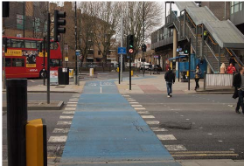
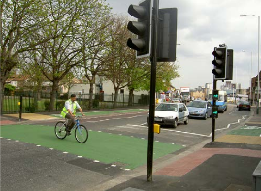

Slide 26
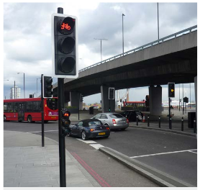
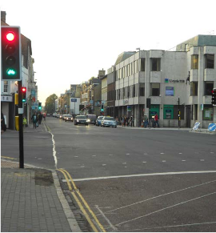

Slide 27
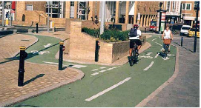
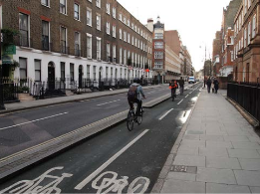
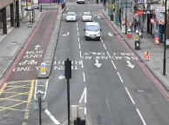
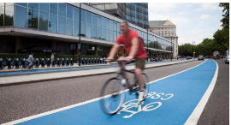

Slide 28
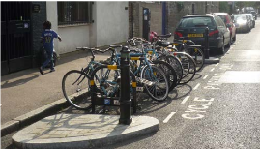
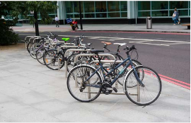
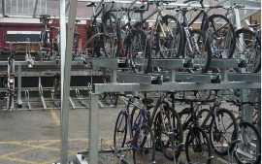
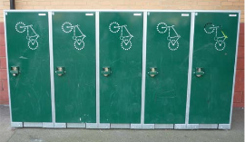

Slide 29
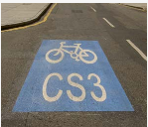
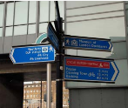
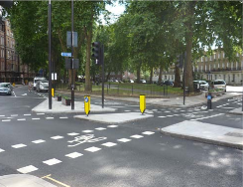
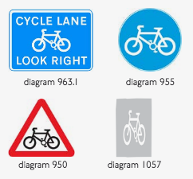
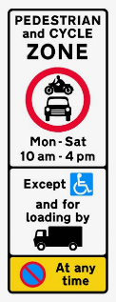
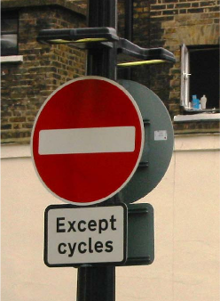

Slide 30
